Slide 1
Hardware process
When the computer is powered up, it begins to execute fetch-execute cycle for the program that is stored in memory at the boot strap entry point
Hardware process is just a name to represent the iterative activity of the control unit, as it fetches and execute instructions.

Slide 2
Fetch execute algorithm
PC = <machine start address>;
IR = memory[PC];
haltFlag = CLEAR;
while(haltFlag not SET)
{
execute(IR);
PC = PC + sizeof(INSTRUCT);
IR = memory[PC]; // fetch phase
}

Slide 3
Algorithms, Programs, and Processes
Idea
Execution Engine
Files
Files
Algorithm
Files
Status
Stack
Source
Program
Binary
Program
Data
Other
Resources
Process

Slide 4
Process Manager Overview
Program
Process
Abstract Computing Environment
File
Manager
Deadlock
Process
Description
Protection
Synchronization
Device
Manager
Memory
Manager
Resource
Manager
Scheduler
Resource
Manager
Resource
Manager
Devices
Memory
CPU
Other H/W

Slide 5
UNIX Organization
Process
Libraries
Process
Process
System Call Interface
File
Manager
Deadlock
Process
Description
Protection
Synchronization
Device
Manager
Memory
Manager
Resource
Manager
Scheduler
Resource
Manager
Resource
Manager
Monolithic Kernel
Devices
Memory
CPU
Other H/W

Slide 6
Process manager responsibilities
Process creation and termination
Thread creation and termination
Resource allocation
Protection & security
Implementing address space
Providing mechanisms for process synchronization
Providing mechanisms for process communication
Providing mechanisms for deadlock handling

Slide 7
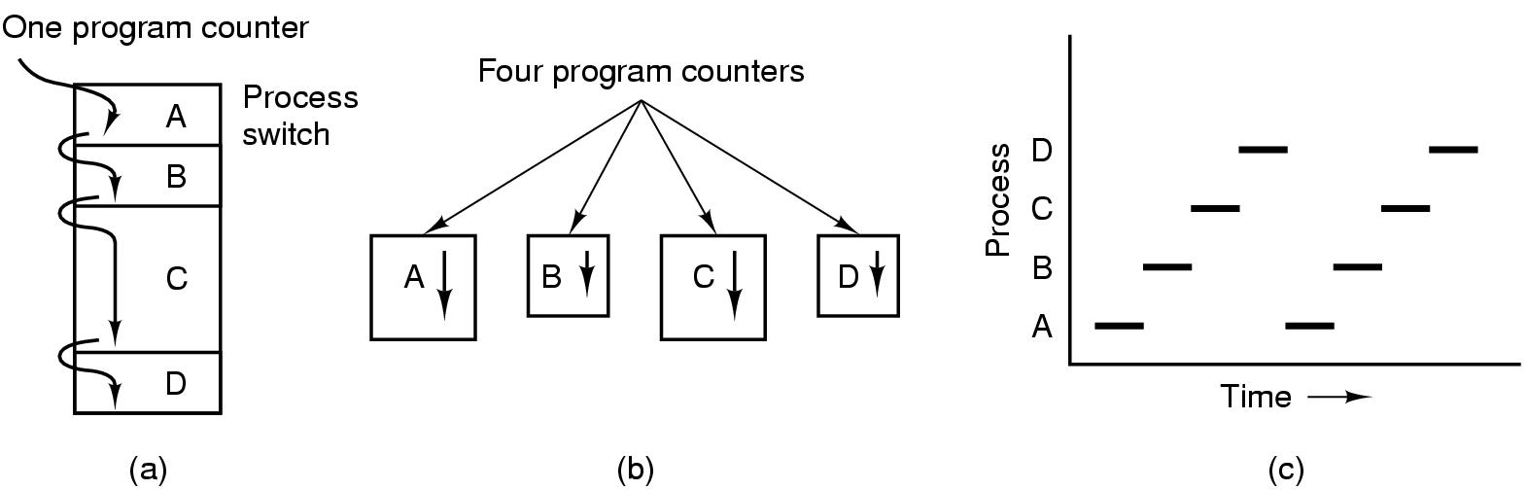
Multiprogramming
(a) Multiprogramming of four programs. (b) Conceptual model of four independent, sequential processes. (c) Only one program is active at once.
Tanenbaum, Modern Operating Systems 3 e, (c) 2008 Prentice-Hall, Inc. All rights reserved. 0-13-6006639

Slide 8
Tracing the Hardware Process
Machine is
Powered up
Bootstap
Process
Manager
Interrupt
Handler
Loader
P₁
P_{,2}
P_{n}
Load the kernel
Initialization
Execute a thread
Schedule
…
Hardware process progress
Service an interrupt
Notes:
Single thread of execution as the hardware process
Initial process - idle thread - executes whenever there are no other ready threads

Slide 9
Process management
The process manager creates the environment in which multiple processes co-exist, each with own abstract machine
When hardware process begin to execute OS code, it will execute an algorithm that switches the hardware process from one context to another
These Context switches can occur when ever OS gets control of the processor.

Slide 10
Processes
A process is the execution of a program
A process is consists of text (machine code), data and stack
Many process can run simultaneously as kernel schedules them for execution
Several processes may be instances of one program
A process reads and writes its data and stack sections, but it cannot read or write the data and stack of other processes
A process communicates with other processes and the rest of the world via system calls

Slide 11
Processes
Kernel has a process table that keeps tract of all active processes
Each entry in the process table contains pointers to the text, data, stack and the U Area of a process.
All processes in UNIX system, except the very first process (process 0) which is created by the system boot code, are created by the fork system call

Slide 12
When a process is created, the process manager algorithm creates a data structure to keep all the details it requires for managing the process.
The process descriptor is the data structure where the OS will keep all information it needs to manage that process.
What information should be kept in a process descriptor ?

Slide 13
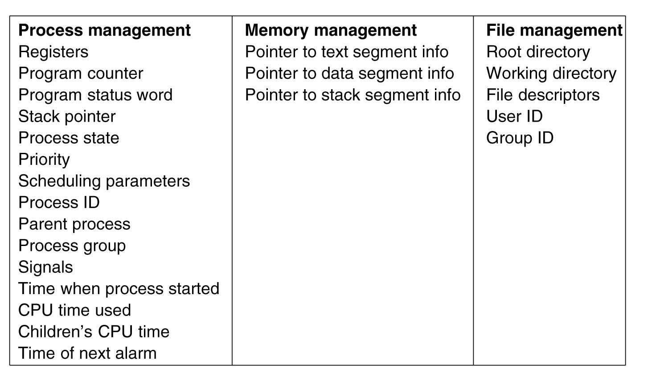
Some of the fields of a typical process table entry
Tanenbaum, Modern Operating Systems 3 e, (c) 2008 Prentice-Hall, Inc. All rights reserved. 0-13-6006639

Slide 14
Process descriptor
Process id | Internal name of the process
state | Process’s current state
owner | Process owner.
threads | List of threads associated with this process
List of related process | List of sibling process
List of child process | A reference to list of child of this process
Address space | A description of the address space and its binding
stack | Location of the stack in the memory

Slide 15
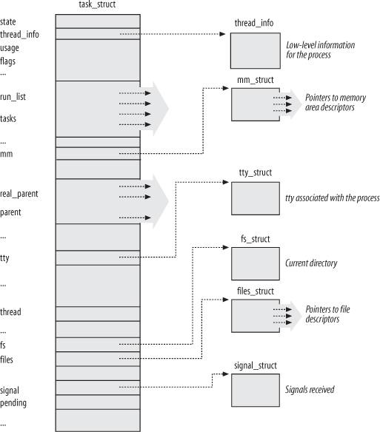
Linux Process Descriptor
Notes:
Execution of the collection of tasks - Managed by the Linux kernel
Struct task_struct is created when a process is created and it is “tied” into the list of tasks

Slide 16
Kernel Support for Process
Kernel Process Table
Kernel Region Table
A Process
Per Process Region Table
Text
File Descriptor Table
Data
Stack
U Area

Slide 17
Process: Region Table
Region table entries describes the attributes of the region, such as whether it contains text or data, whether it is shared or private
The extra level from the per process region table to kernel region table allows independent processes to share regions.

Slide 18
Process: U Area
U Area is the extension of process table entry.
Fields of process table entry:
State field
User ID (UID)
Fields of U Area
Pointer to process table entry
File descriptors of all open files
Current directory and current root
I/O parameters
Process and file size limit
Kernel can directly access fields of the U Area of the executing process but not of the U Area of other processes

Slide 19
Process context
The context of a process consists of the contents of its (user) address space and the contents of hardware registers and kernel data structures that relate to the process.
Formally, the context of a process is the union of its user-level context ; register context , and system -level context .
The user-level context consists of the process
text, data, user stack, and shared memory that occupy the virtual address space of the process.

Slide 20
Register context
The register context consists of the following component
The program counter specifies the address of the next instruction the CPU willexecute;
The processor status register (PS) specifies the hardware status of the machine as it relates to the process.
The stack pointer contains the current address of the next entry in the kernel or user stack, determined by the mode of execution.
The general-purpose registers contain data generated by the process during its execution.

Slide 21
System level context
The system-level context of a process has a "static part and a "dynamic part“. A process has one static part of the system-level context throughout its lifetime, but it can have a variable number of dynamic parts.
The process table entry of a process
The u area of a process
Per region entries, region tables and page tables, define the mapping from virtual to physical addresses
The kernel stack which contains the stack frames of kernel procedures .
The dynamic part of the system-level context of a process consists of a set of layers, visualized as a last-in-first out stack. Each system -level context layer contains the necessary information to recover the previous layer, including the register context of the previous level.

Slide 22
Context Switch
When the kernel decides that it should execute another process, it does a context switch, so that the system executes in the context of the other process
When doing a context switch, the kernel saves enough information so that it can later switch back to the first process and resume its execution.
the kernel saves the context of a process whenever it pushes a new system context layer.

Slide 23
Context Switching
Executable Memory
Initialization
1
Process
Manager
Interrupt
7
8
Interrupt
Handler
2
P₁
3
4
9
P₂
5
6
P_{n}
Notes:
Context switch can take place when OS gets control of processor
ABOVE: first nine context switches
Process manager performs all the context switching

Slide 24
Mode of Process Execution
The UNIX process runs in two modes:
User mode
Can access its own instructions and data, but not kernel instruction and data
Kernel mode
Can access kernel and user instructions and data
When a process executes a system call, the execution mode of the process changes from user mode to kernel mode

Slide 25
Mode of Process Execution
When moving from user to kernel mode, the kernel saves enough information so that it can later return to user mode and continue execution from where it left off.
Mode change is not a context switch, just change in mode.

Slide 26
State of a Process
State Variable - summary status of the process/thread which is located in descriptor
Request
Simple State Diagram
Done
Running
Request
Schedule
Allocate
Start
Blocked
Ready
Notes:
Transitions from one state to another
Running - request -> either get resource & continue running or not get resource & block

Slide 27
